Slide 1
Brief introduction of DL with Pytorch

Slide 2
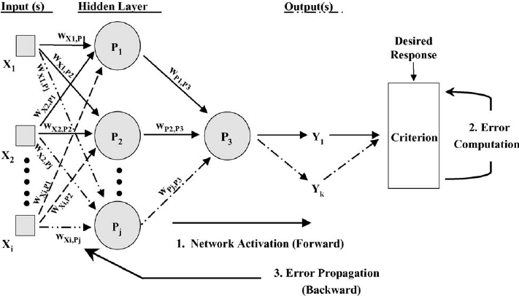
Two weeks ago
Feed-Forward neural network
Input, Hidden, Output layer
Forward propagation
Prediction
Loss function
Backward propagation
Training
(1) Feed-forward neural network
Notes:
perceptron 傳遞

Slide 3
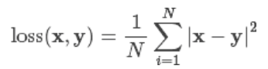
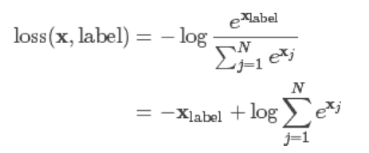
How does MLP model works?
The choice of loss function is depend on what the problem you want to solve.
Regression?
Classification ?
→ MSE (Mean Square Error)
→ CrossEntropy
→ L1, SmoothL1, etc.
(1) MSE
(2) Cross Entropy
Notes:
針對不同問題定義不同loss function: https://datascience.stackexchange.com/questions/9850/neural-networks-which-cost-function-to-use

Slide 4
How about designing an image classifier with pure MLP?
Network size Explosion！

Slide 5
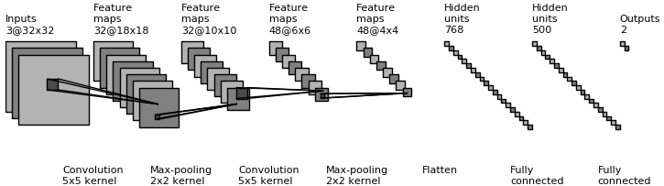
Convolution Neural Network
Architecture Overview
Convolution
3D volumes of neurons
Feature extraction
Weight sharing
Activaction function
Maxpooling
Subsampling
Fully connection
(1) CNN architecture
Notes:
扮演的角色
conv想像成3D神經元
後曾Conv

Slide 6
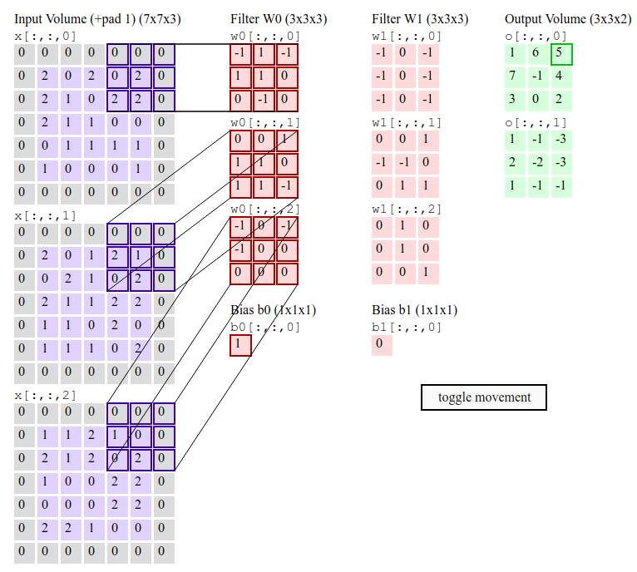
Convolution
（2） convolution operation
source:stanford cs231n
（2） multi-channel input

Slide 7
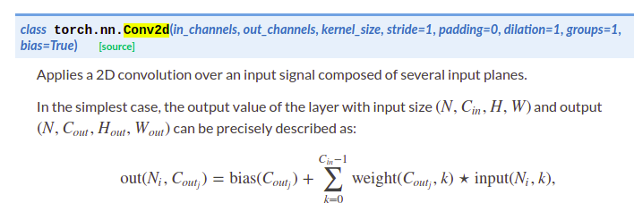
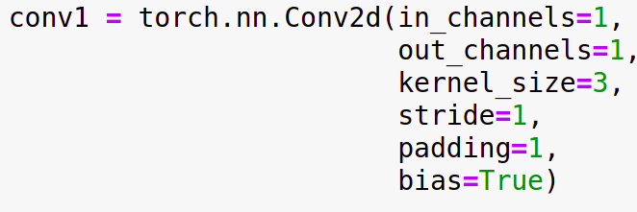
Convolution layer
p=0, s=1
p=1, s=1
p=1, s=2
torch.nn [link]
Use torch.nn module to declare convolution operation
source:stanford cs231n
Notes:
進行內積

Slide 8
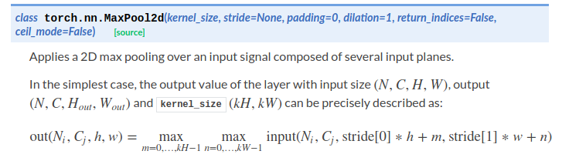
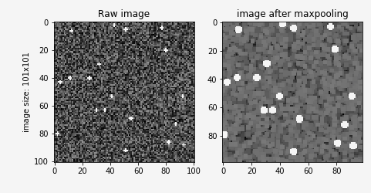
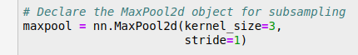
Maxpool
Downsampling without feature loss?
see example 1

Slide 9
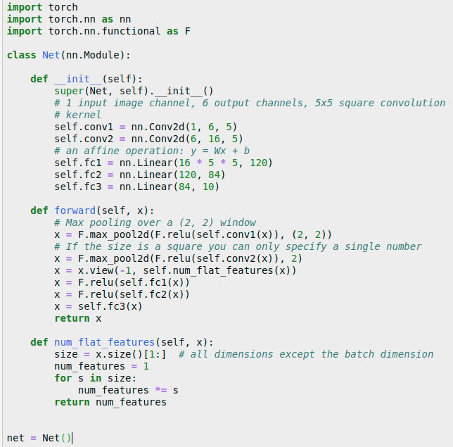
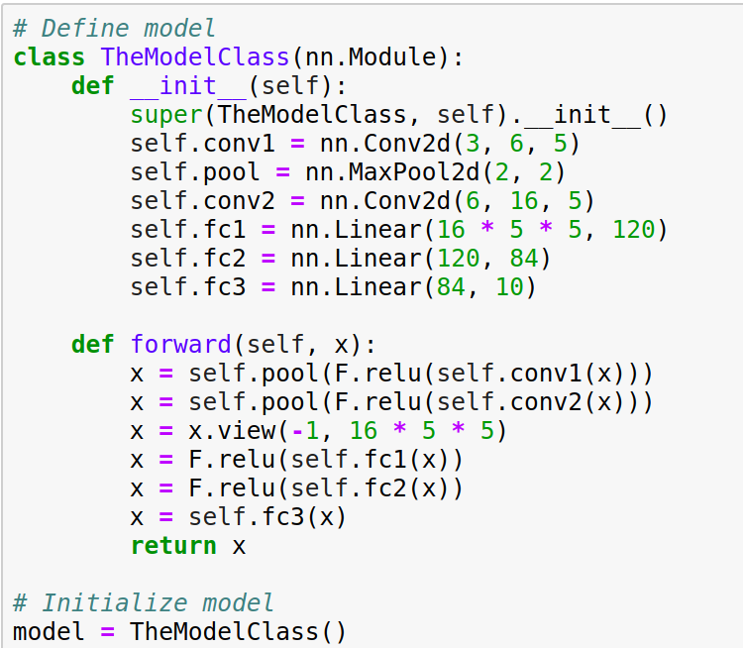
Fully connection
Operate like MLP
flatten code 1
flatten code 2

Slide 10
Fully connection
Features must be flatten!
flatten code 1
flatten code 2

Slide 11
Software architecture
Review
CNN also need a criterion to evaluate the model is good enough?
→ MSE (Mean Square Error)
→ CrossEntropy
→ L1, SmoothL1, etc.
(1) Feed-forward neural network

Slide 12
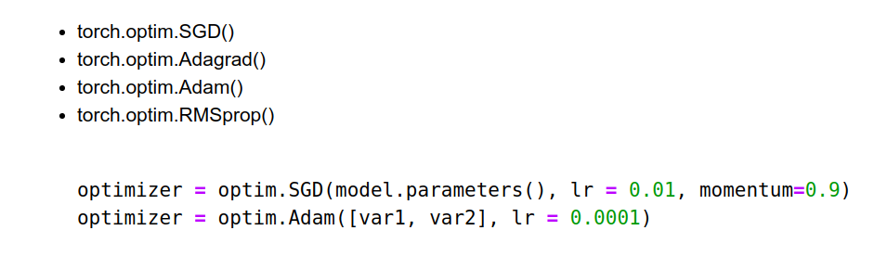
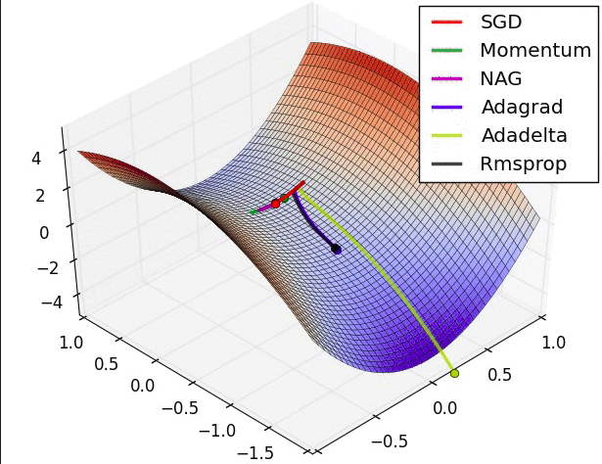
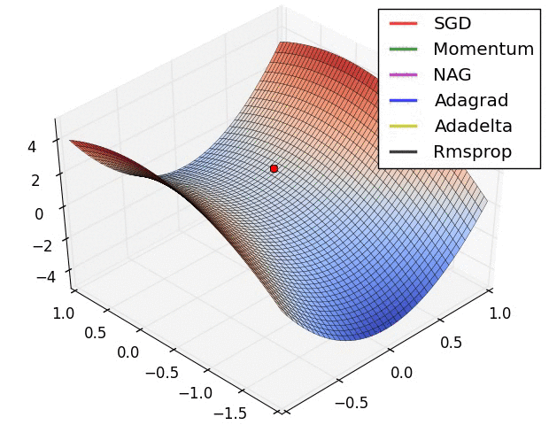
Optimizer
torch.optim [link]
Hyperparameters(learning rate, momentum of gradient descent)
loss function with weight

Slide 13
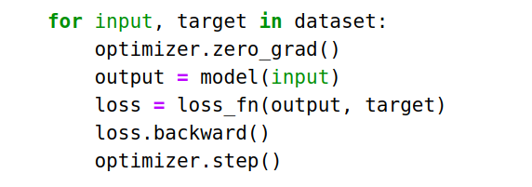
Optimizer
torch.optim
Pseudo code
Notes:
包住model parameter

Slide 14
Software architecture
predict → criterion (loss) → optimize(backward propagation)
Save the model?
Load Model to continune training?
(1) Feed-forward neural network

Slide 15
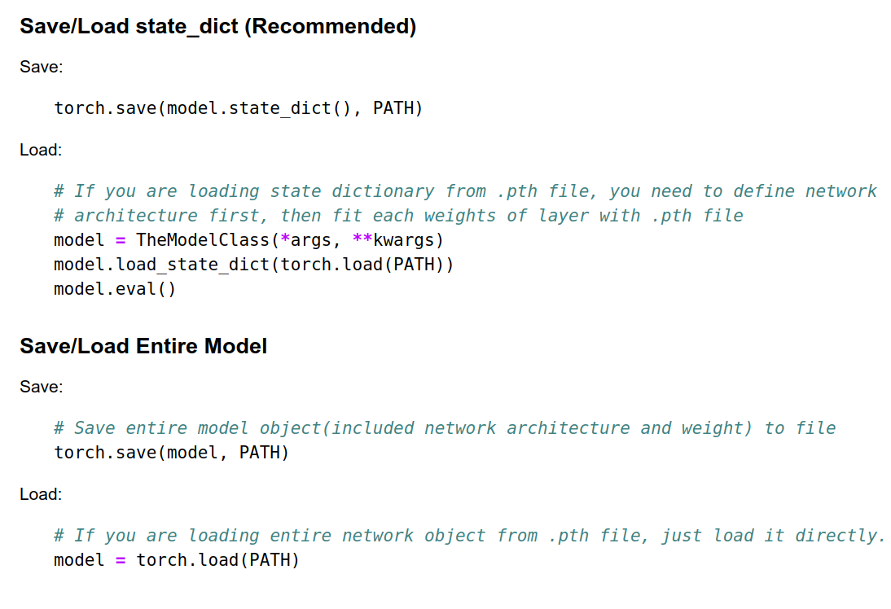
Save/ load pretrained model with Pytorch
*.pth file
Save/load state_dict
State dictionary
Save/load entire model
Entire network object
Compare this two mex

Slide 16
Tutorial & assignment review

Slide 17
Training/Testing on GPU with Pytorch
Concept
Move data from main memory to GPU memory? data?
Network object
model.cuda()
Input_data
input_data.cuda()
Label
label.cuda()
Visualization
Move data to main memory (.cpu() )and convert it to ndarray
Matplotlib doesn't support GPU machine!!

Slide 18
Reference
Pytorch official tutorial [link]
MILA pytorch tutorial[link]
台大李宏毅教授Machine Learning [link]
莫煩Pytorch [link]
Stanford CS231n [link]

